Slide 1

Whitford Country Club
A Database Project by Mark Miller

Slide 2

Table of Contents:

Slide 3
Executive Summary:

Slide 4
ER-Diagram

Slide 5
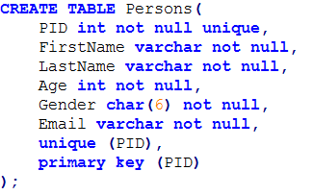
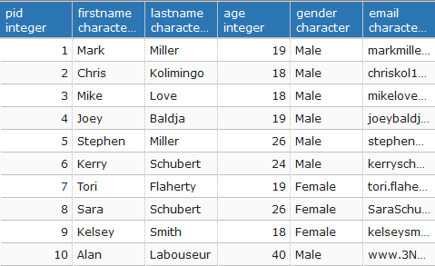
Create Table Statements: Persons Table
This is the most important table as it is the beginning in which we distinguish every person with a PID, name and important information about themselves. The PID is the primary key as it acts as the beginning to distinguishing a member from an employee.
Functional Dependencies:
PID → FirstName, LastName, Age, Gender, Email
Sample data:

Slide 6
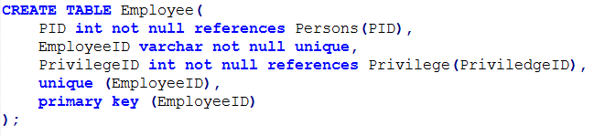
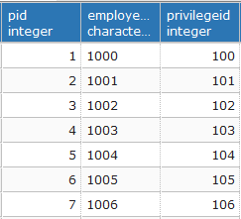
Create Table Statements: Employee Table
The Employee Table places a crucial role as it links many of the other tables that are associated with an employee. We also define and store the EmployeeID into this table. This table references the Persons table through the PID and uses the EmployeeID as its primary key. There is a decision node placed on the employee side because of the choice between a employee or member.
Functional Dependencies:
EmployeeID → PID, PrivilegeID

Slide 7
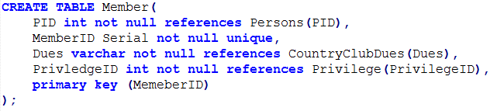
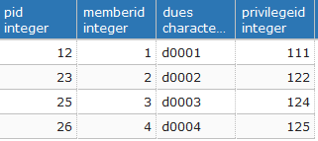
Create Table Statements: Member Table
Another crucial table as it links all member related table to it by a MemberID. The MemberID servers as the primary key and references the Persons table by the PID. Again we place a decision node on the member side because you can either be a member or an employee.
Functional Dependencies:
MemberID → PID, Dues, PrivilegeID

Slide 8
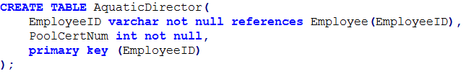

Create Table Statements: AquaticDirector Table
This is one of many jobs that are associated with being an Employee. EmployeeID is again the primary key and references the Employee Table. The AqauticDirector also has a Pool Certificate Number associated with him. A decision node is placed on this side as it is a job decision.
Functional Dependencies:
EmployeeID → PoolCertNum

Slide 9
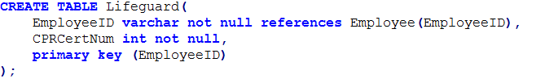
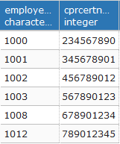
Create Table Statements: Lifeguard Table
Another job associated with being an Employee and follows the same principles as the AquaticDirector table. It references EmployeeID and has an CPR Certificate Number associated with it too. We again place a decision node on this side of the table to show the choice of being a lifeguard.
Functional Dependencies:
EmployeeID → CPRCertNum

Slide 10
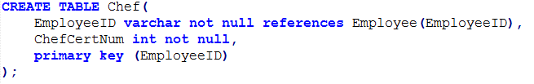
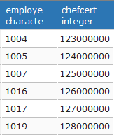
Create Table Statements: Chef Table
Following the other job tables, this table sets the primary key as the EmployeeID and references the Employee table with it. The Chef table also has a Chef Certificate Number within it. The decision node is used on this side of the table to show the choice of being a chef.
Functional Dependencies:
EmployeeID → ChefCertNum

Slide 11
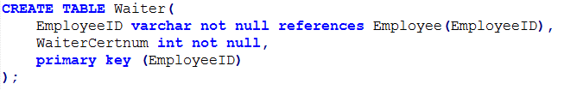
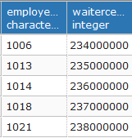
Create Table Statements: Waiter Table
The waiter table follows all other job tables in that we set the EmployeeID as the primary key and reference the Employee table to get it. The Waiter table also as a Waiter Certificate number corresponding with it. A decision node is used to show a decision is made on choosing this job.
Functional Dependencies:
EmployeeID → WaiterCertNum

Slide 12
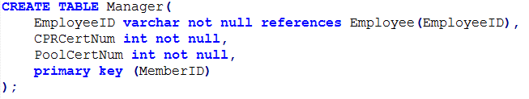
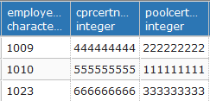
Create Table Statements: Manager Table
The final job table is the Manager table. This again sets the EmployeeID to be the primary key and references the Employee table to get it. It then also has both a CPR and Pool Certificate Number in its table. Like the rest a decision node is used to represent the choice between a manager or any other job.
Functional Dependencies:
EmployeeID → PoolCertNum, CPRCertNum

Slide 13
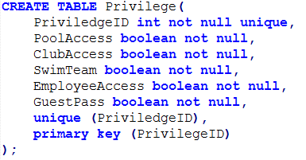
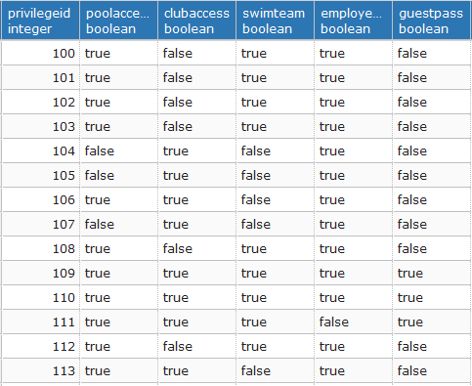
Create Table Statements: Privilege Table
The privilege table represents the privileges that each employee or member has access to. The PrivilegeID is stored within this table and is referenced in both the employee and member table. The PrivilegeID is used as the primary key in this table.
Functional Dependencies:
PrivilegeID → PoolAccess, ClubAccess, SwimTeam, EmployeeAccess, GuestPass

Slide 14
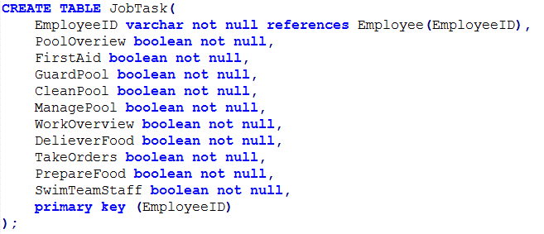
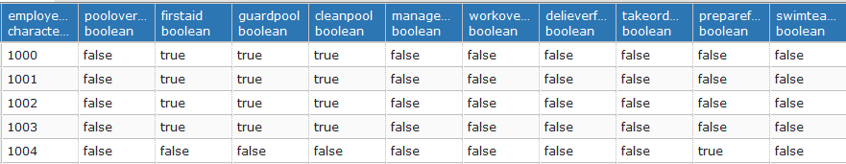
Create Table Statements: JobTask Table
This table is very similar to the Privilege table in that it defines all of the job task assigned to a specific person. We use the EmployeeID as the primary key and references the Employee table once again.
Functional Dependencies:
EmployeeID → PoolOverview, FirstAid, GuardPool, CleanPool, ManagePool, WorkOverview, DelieverFood, TakeOrders, SwimTeamStaff

Slide 15
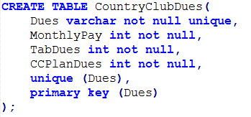
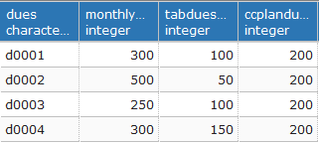
Create Table Statements: CountryClubDues Table
This table signifies all of the payments that a member must make to the Country Club. We use Dues as the primary key and store it within this table. Dues is referenced by the Member table in order to gain access.
Functional Dependencies:
Dues → MonthlyPay, TabDues, CCPlanDues

Slide 16
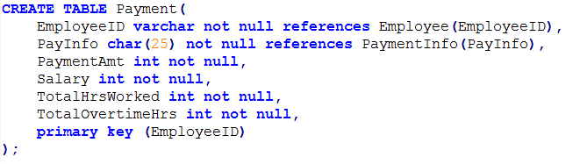
Create Table Statements: Payment Table
This table uses a EmployeeID once again as its primary id and describes all of the factors that go into your payments and the total payment that you get.
Functional Dependencies:
EmployeeID → PAyInfo, PaymentAmt, Salary, TotalHrsWorked, TotalOvertimeHrs

Slide 17
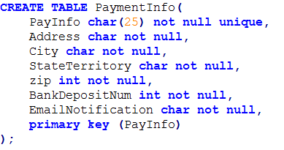
Create Table Statements: PaymentInfo Table
The final table in our database is the PaymentInfo table which specifies all of the needed information when a employee is being paid. The primary key is the PayInfo which is unqiue for every person.
Functional Dependencies:
PayInfo → Address, City, StateTerritory, zip, BankDepositNum, EmailNotification

Slide 18
SQL Code Link:
https://github.com/markyMARK0702/LinkedIn-Projects/blob/master/Mark_Miller_Final_Project_WCC.sql

